Slide 1

Project 1
Pertemuan 13
Dr. Dedi Trisnawarman

Slide 2
Session
Preparation
Extract Transform Load
Cube

Slide 3
Software
Visual Studio 2017 community edition
https://visualstudio.microsoft.com/downloads/
SQL Server Data Tools
https://docs.microsoft.com/en-us/sql/ssdt/download-sql-server-data-tools-ssdt?view=sql-server-2017
SQL Server 2017 developer
https://www.microsoft.com/en-us/sql-server/sql-server-downloads

Slide 4
Skill
Basic understanding with T-SQL and SQL Server
Basic Knowledge of data warehouse concepts

Slide 5
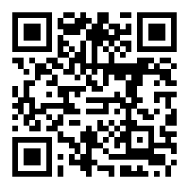
Data
https://mega.nz/#F!DBt2jSKT!Vea-UGVv3CS1d0nVzy3ReA

Slide 6
Restore Backup Data
https://campus.barracuda.com/product/backup/doc/15892599/how-to-restore-a-microsoft-sql-database-to-a-point-in-time/

Slide 7
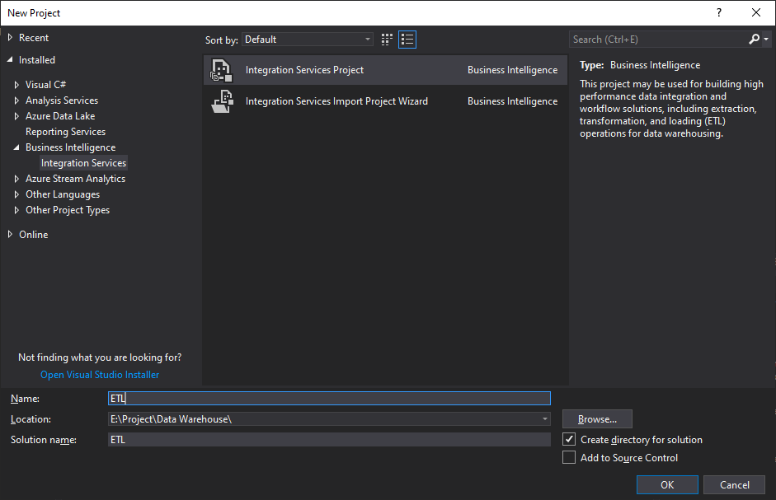
Create New Project

Slide 8
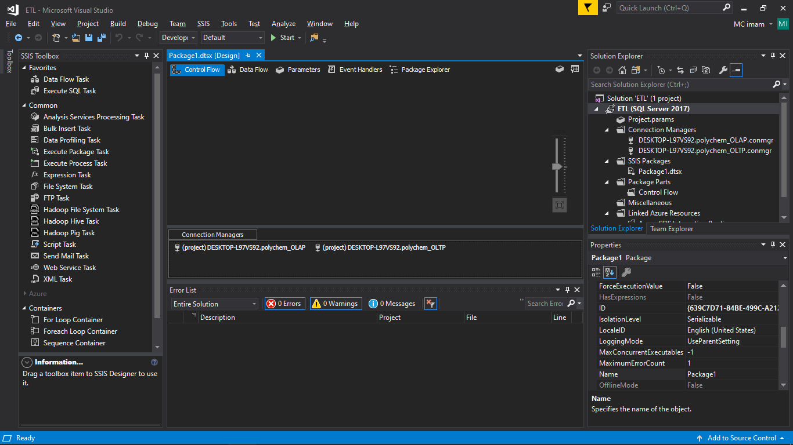

Slide 9
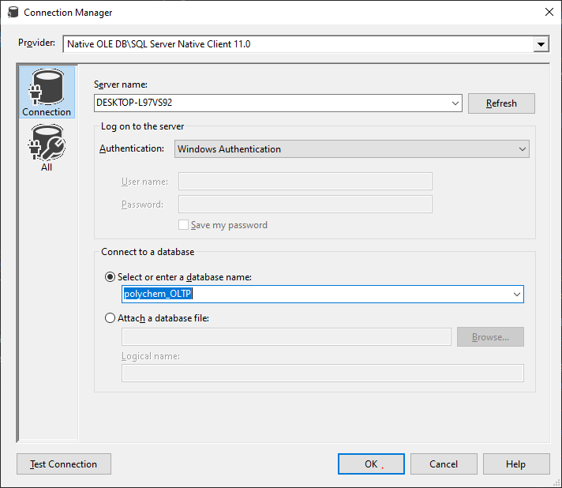
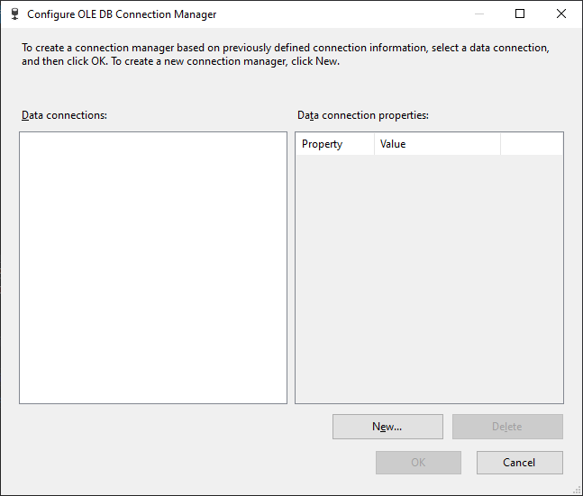
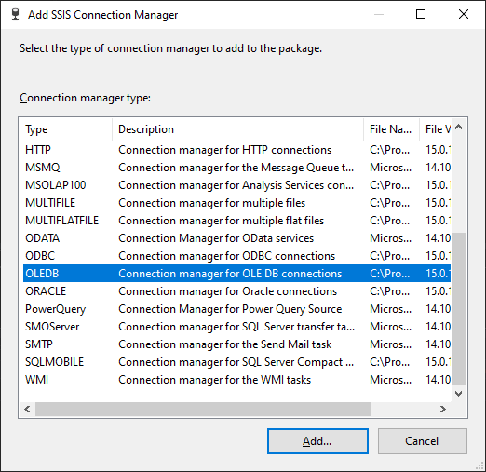
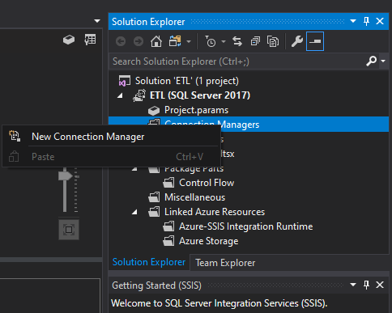
Add New Connection
Right click on “Connection Manager”
Select New Connection
Choose Connection type ( OLEDB)
Add new Connection
Insert Connection detail

Slide 10
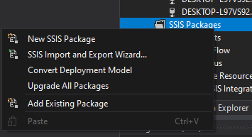
Add SSIS package
Right click on SSIS Packages
Click New SSIS Package

Slide 11
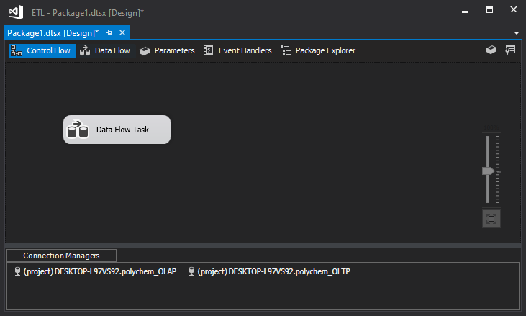
Add Data Flow
Drag and drop data flow task from SSIS toolbox to Control flow tab in SSIS designer

Slide 12
Extract from OLTP Database
Transform to match OLAP Database
Load to OLAP Database
Remember what to do

Slide 13
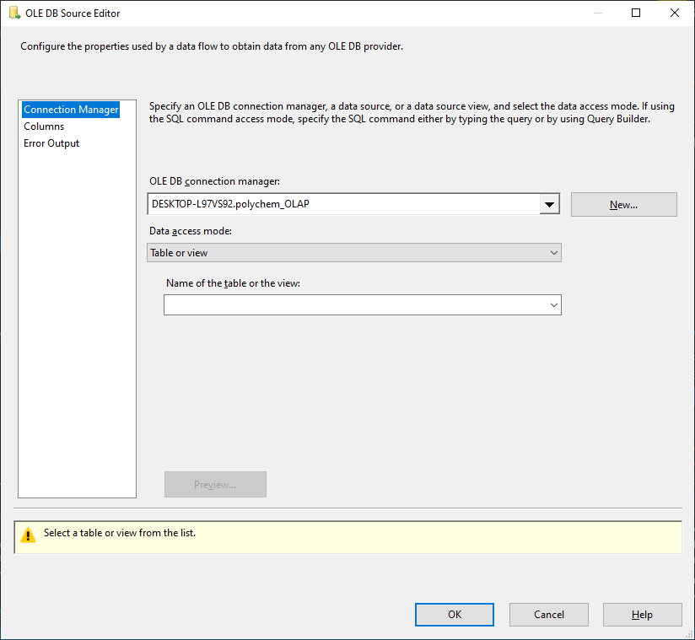
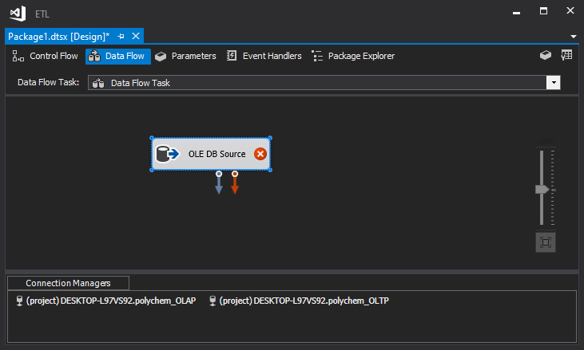
Add Data Source
Add new data source
Select connection
Select Table
Configure

Slide 14
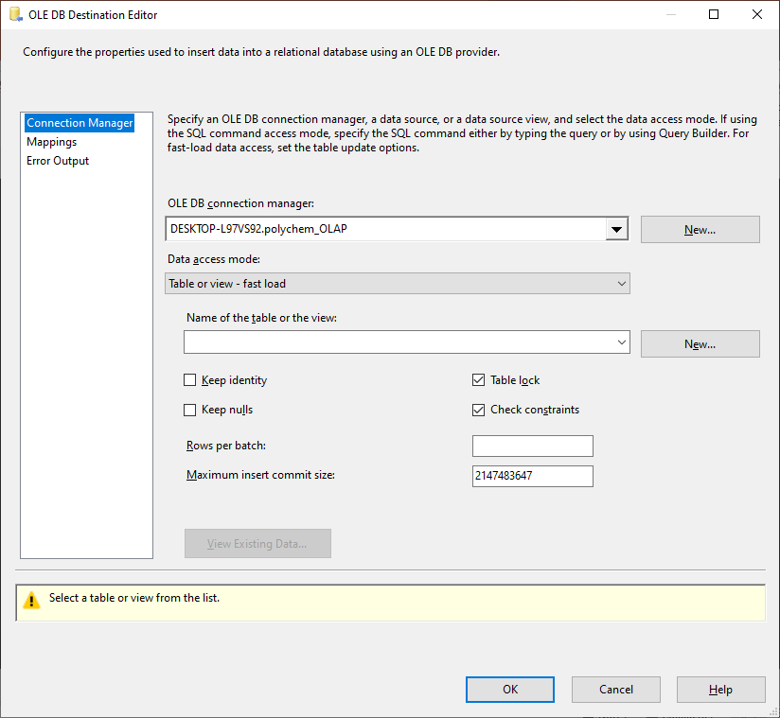
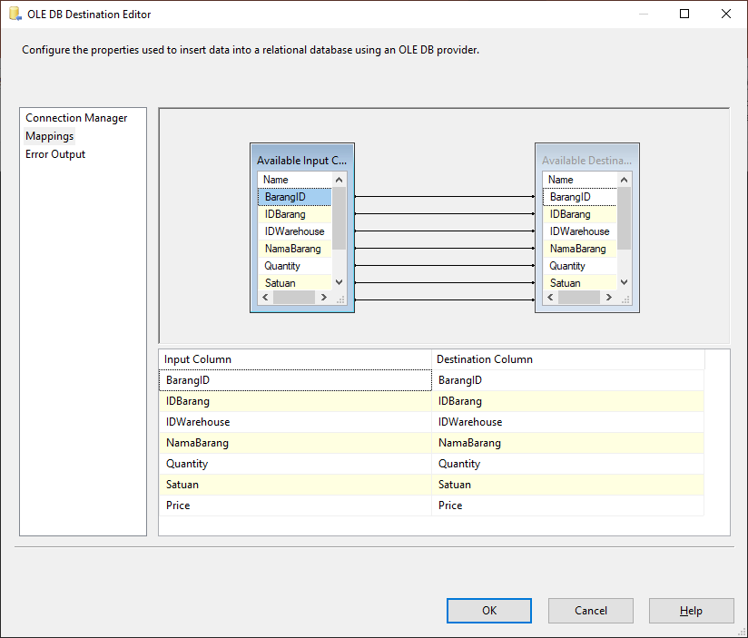
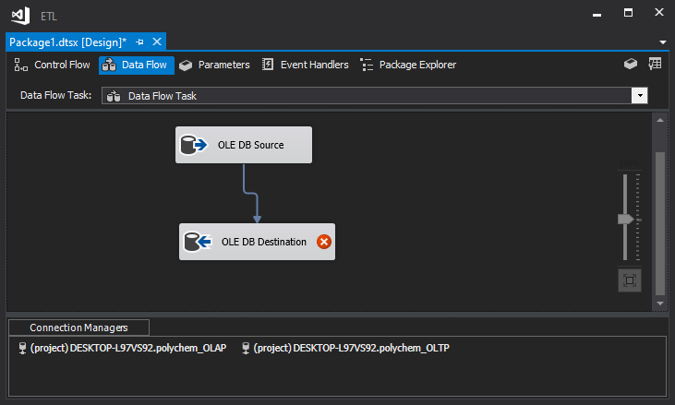
Add Data Destination
Add database destination
Select connection
Configure table mappings

Slide 15
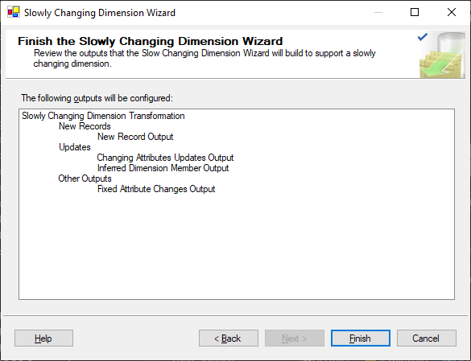
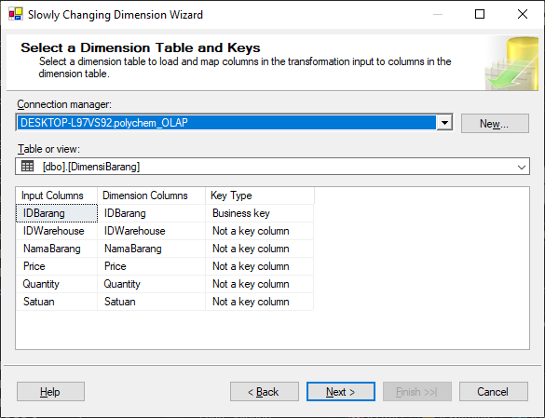
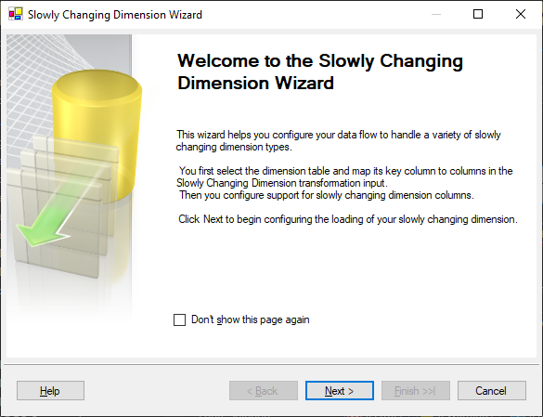
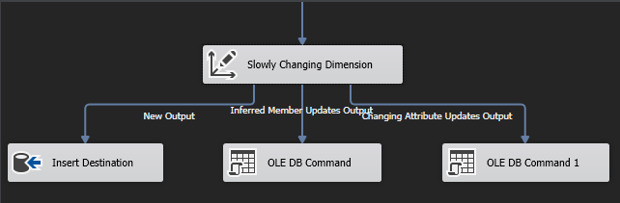
Slowly Changing Dimension

Slide 16
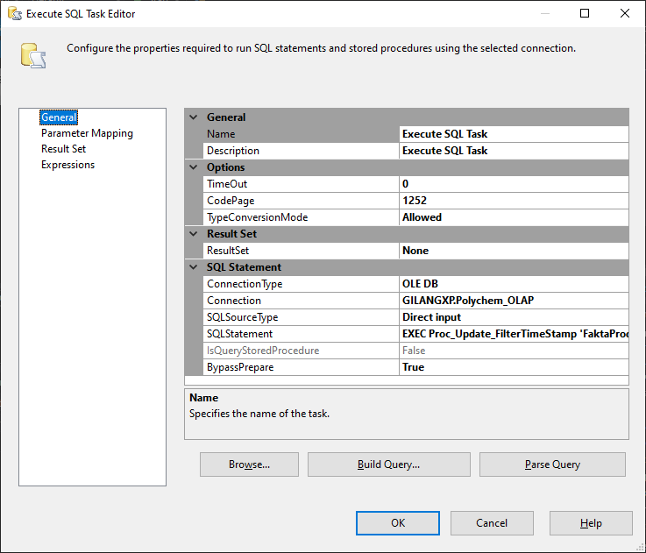
Execute SQL Task
1. Choose connection
2. Insert query

Slide 17
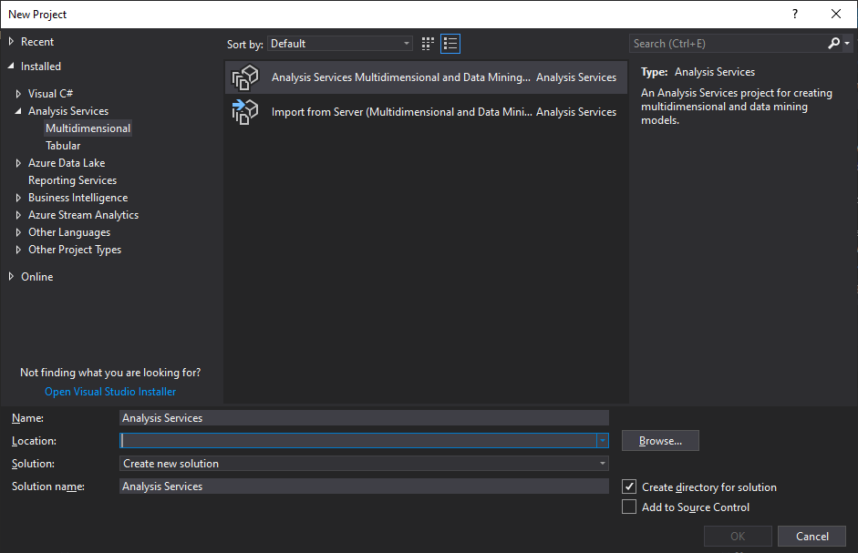
Create New Project

Slide 18
Add Data Source
Add new data source
Select connection
Select Table
Configure

Slide 19
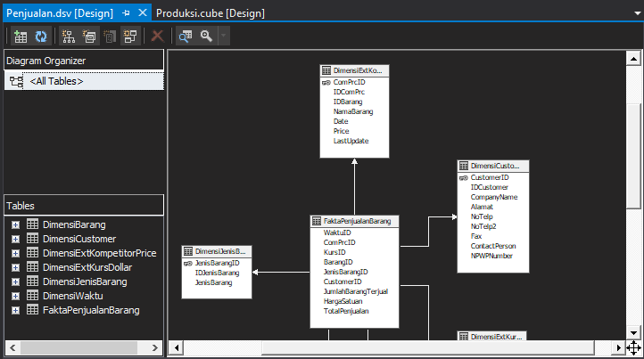
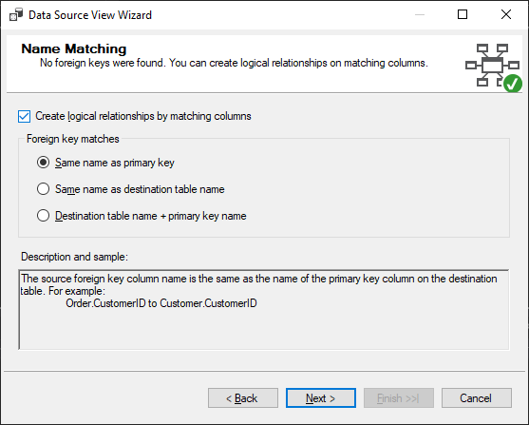
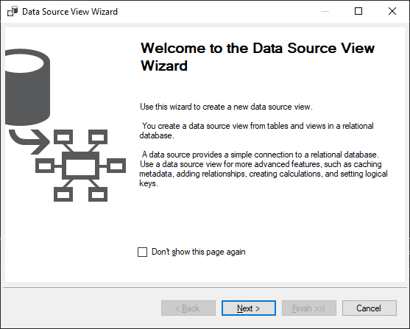
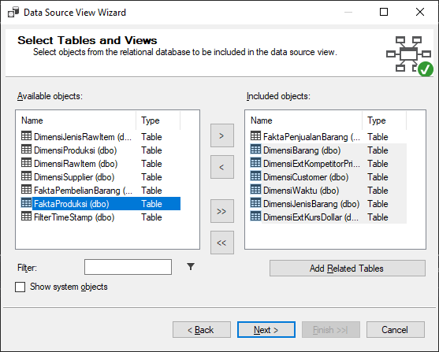
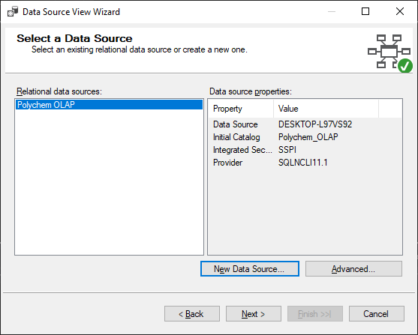
Add Data Source View
1. Add data connection
2. Follow the wizard

Slide 20
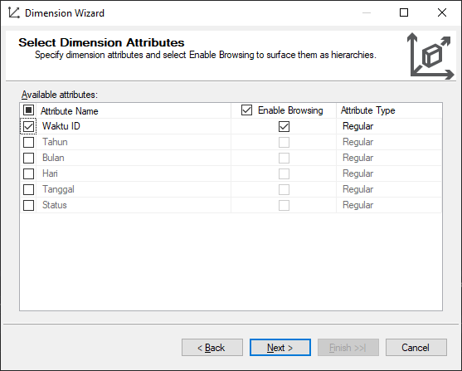
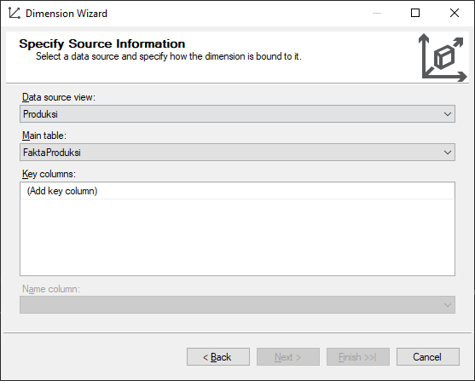
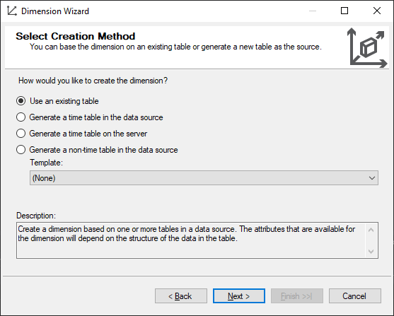
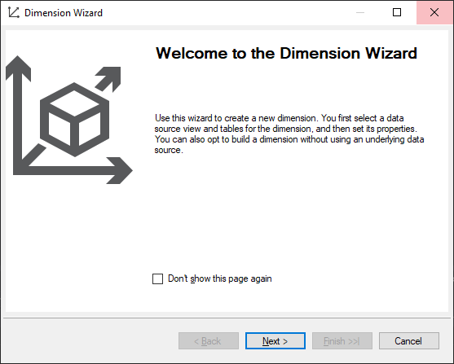
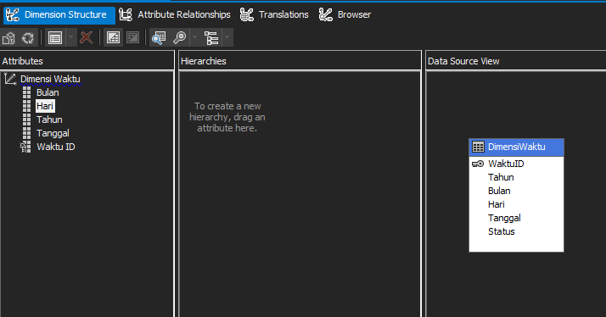
Add New Dimension
1. Select Creation Method
2. Add Source
3. Select Attributes

Slide 21
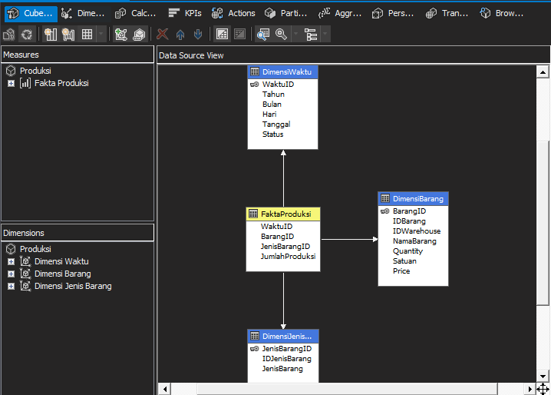
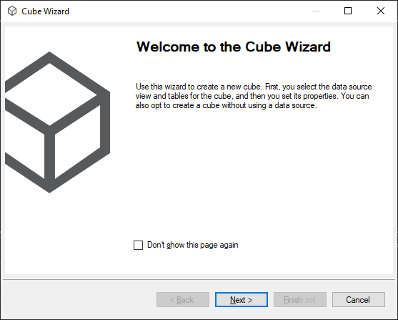
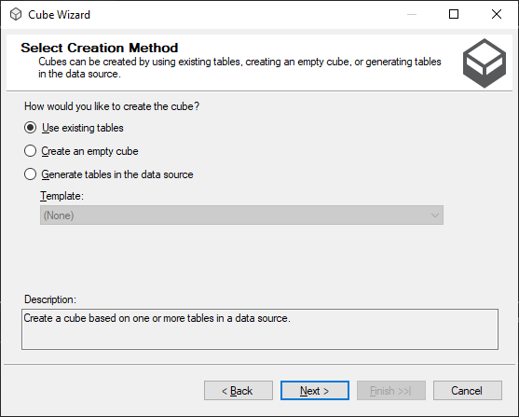
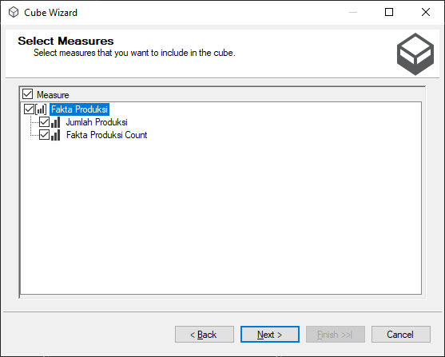
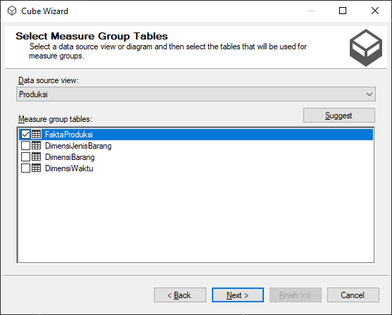
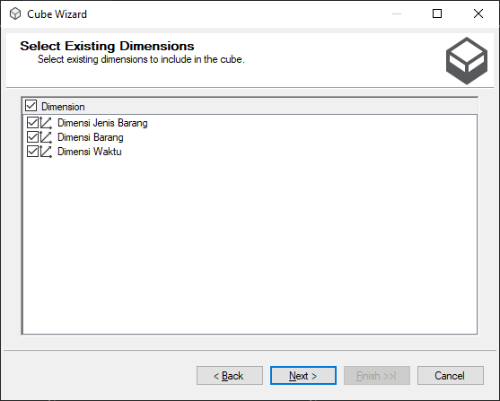
Add Cube

